Slide 1

Micro-Credit Defaulter Model
Aaron D'souza
Notes:
We designed this template so that each member of the project team has a set of slides with its own theme. Members, here’s how you add a new slide to just your set:
Mark where you want to add the slide: Select an existing one in the Thumbnails pane, click the New Slide button, then choose a layout. The new slide gets the same theme as the other slides in your set.
Careful! Don’t annoy your fellow presenters by accidentally changing their themes. That can happen if you choose a different theme from the Design tab, which changes all of the slides in the presentation to that look.

Slide 2
Agenda / Topics
Problem Definition
Data Analysis
EDA (Exploratory Data Analysis)
Pre-processing Pipeline
Building Machine Learning Models
Concluding Remarks

Slide 3
Problem Definition
A Microfinance institution is an organization that offers financial services to low-income populations.
Almost all Microfinance institutions give loans to their members, and many offer insurance, deposit, and other services.
MFS becomes very useful when targeting especially the unbanked poor families living in remote areas with not many sources of income.
It is very important for a Microfinance Institution (MFI) to know whether an individual will be able to repay the loan provided to them within a certain timeframe or not.

Slide 4

Data Analysis
The goal is to build a model that can predict in terms of a probability for each loan transaction, whether the customer will be paying back the loaned amount within 5 days of insurance of loan.

Slide 5
Data Analysis
The sample data is provided to us from our client database.
The goal is to improve the selection of customers for the credit, the client wants some predictions that could help them in further investments and improvement in selection of customers.
A total of three datatypes in the dataset Float, Int and Object.
The data provided was well organized structured data in .CSV (comma-separated values) format.

Slide 6
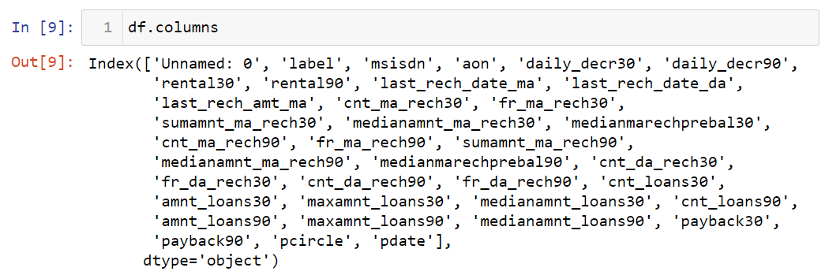
Data Analysis
The data set has a total of 37 columns:

Slide 7
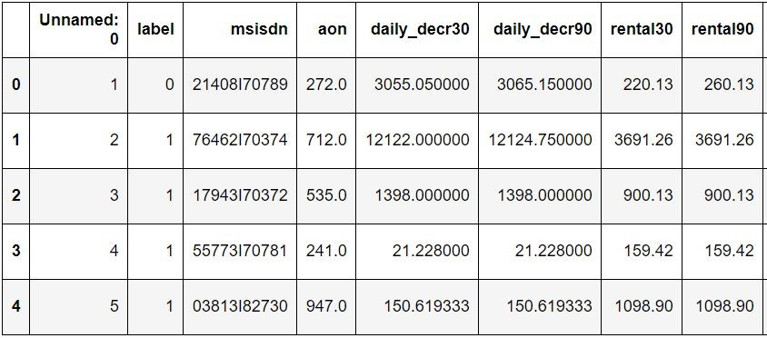
Data Analysis
Data-Frame Sample

Slide 8
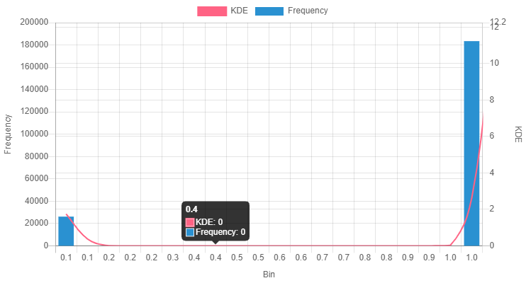
EDA (Exploratory Data Analysis)
The plot in Fig. 1 describes the distribution of "Label” column in the data set. A total amount of 26,162 individuals were not able to repay the loan amount on time. 1,83,431 individuals repaid their loan on time. The Loan repayment rate was 88 %.

Slide 9
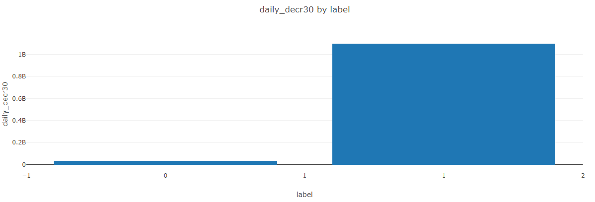
EDA (Exploratory Data Analysis)
The plot in Fig.3 shows the bivariate relationship between daily decrease 30 (Daily amount spent from main account, averaged over last 30 days (in Indonesian Rupiah) and the Label column. We can distinctly conclude that the average amount spent by an individual per 30 days is very low for those individuals who have failed to repay the loan. So, basically the loan provider should check the average spending's of an individual before granting them loan.

Slide 10
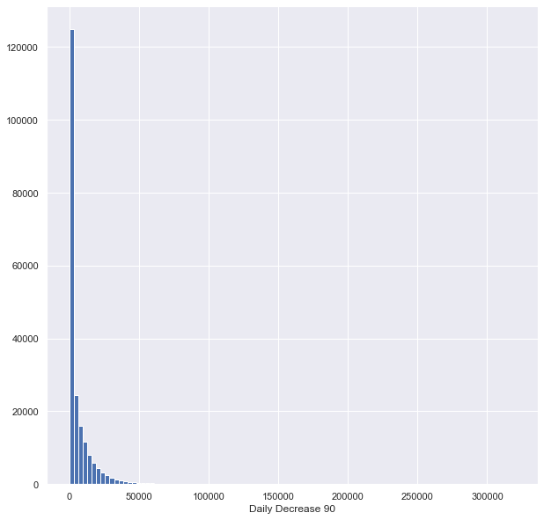
EDA (Exploratory Data Analysis)
The plot in Fig.5 shows the Hist plot for the column daily decrease 90 (Daily amount spent from main account, averaged over last 90 days (in Indonesian Rupiah). 6124.76 (Indonesian Rupiah) was the average amount spent by an individual over 3 months.

Slide 11
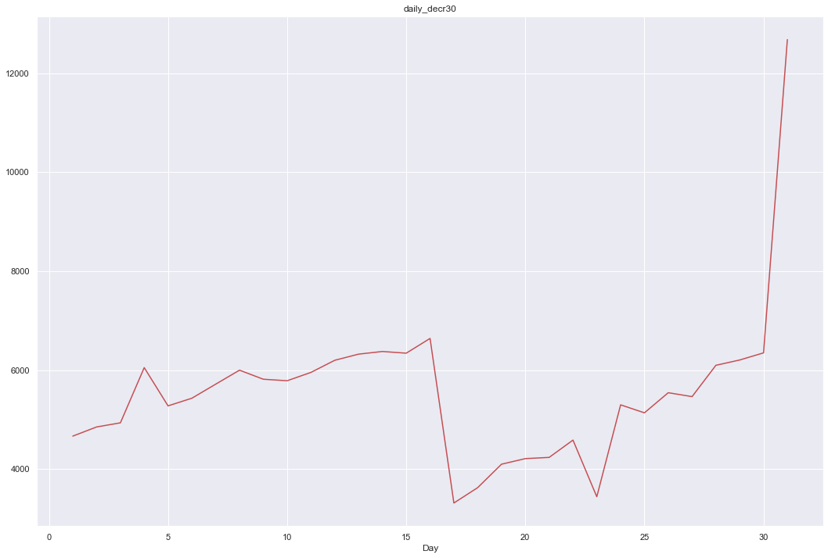
EDA (Exploratory Data Analysis)
The plot in Fig.6 is for the daily_decr30 i.e., the daily amount spent from main account, averaged over last 30 days (in Indonesian Rupiah). It is the average of the amount spent by an individual per month. The average amount spent by an individual per month is ~ 5423.35(in Indonesian Rupiah). From the above pattern we can observe that there is an exponential peak for the average amount spent during the last weeks of the month.

Slide 12
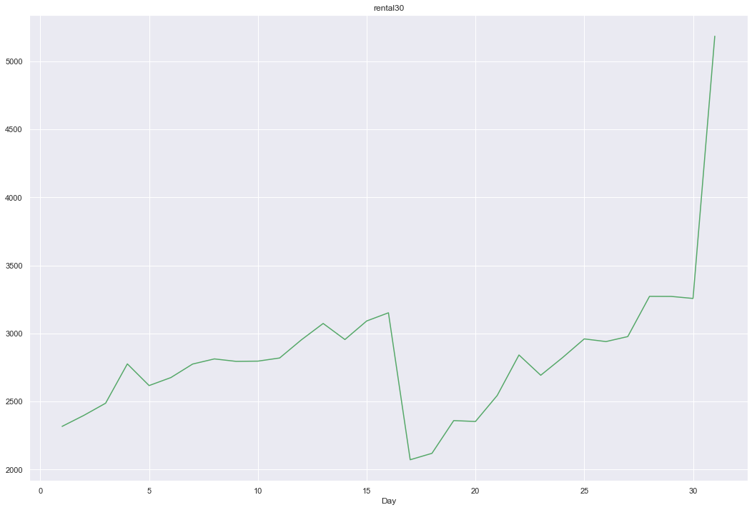
EDA (Exploratory Data Analysis)
The plot in Fig.7 is for the rental_30 i.e., the Average main account balance over last 30 days (in Indonesian Rupiah). The average main account balance per individual is ~ 2772.19. From the above plot we can say that, in the beginning of the month the main account balance is pretty low. As the month end approaches the account balance has an exponential increase.

Slide 13
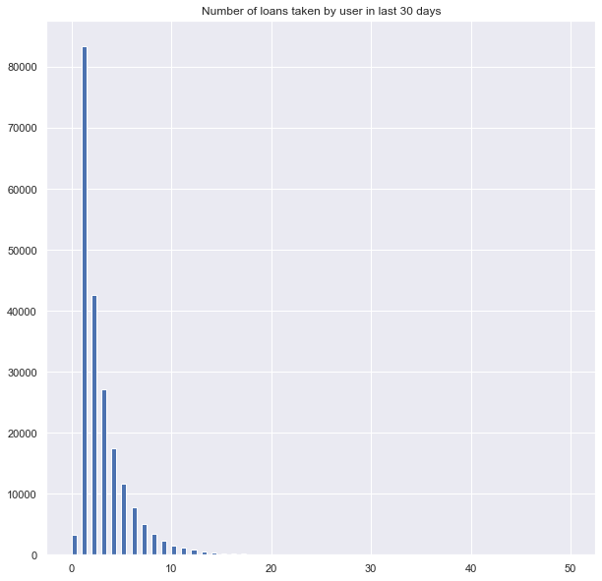
EDA (Exploratory Data Analysis)
The plot in Fig.8 is the Hist plot for the cnt_loans30 i.e., the Number of loans taken by user in last 30 days. On an average an individual took ~ 3 loans in a month (over 30 days).

Slide 14
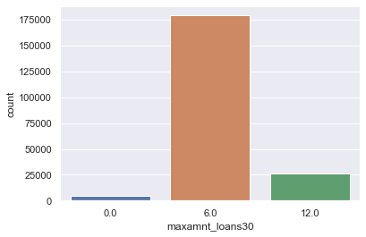
EDA (Exploratory Data Analysis)
The plot in Fig.8 is the seaborn count plot for the maxamnt_loans30 i.e., the maximum amount of loan taken by the user in last 30 days. User has two options 5 & 10 Rs., for which the user needs to pay back 6 & 12 Rs. Respectively. From the count plot above, we can say that most of the individuals have taken 5 Rs (in Indonesian Rupiah) loan so they have to repay 6 Rs. Very few Individuals have taken 12 Rs loan.

Slide 15
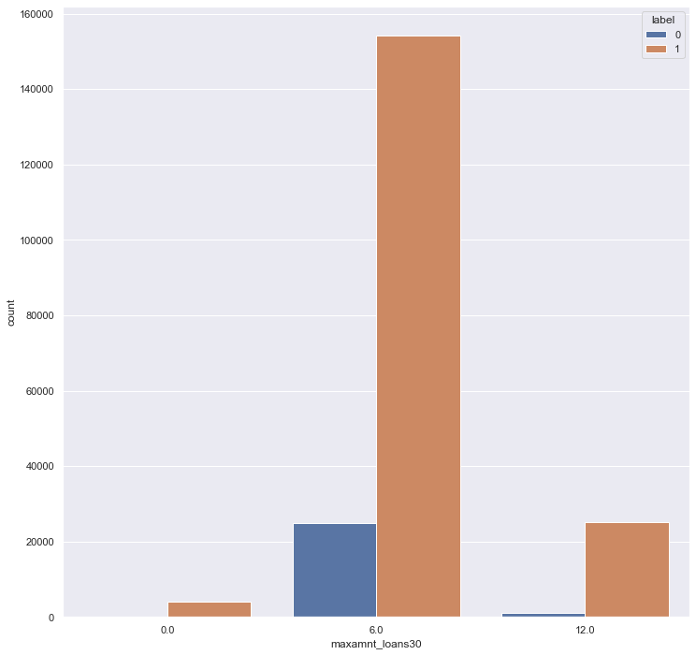
EDA (Exploratory Data Analysis)
The plot in Fig.9 is the seaborn count plot with hue as label for the maxamnt_loans30 i.e., the maximum amount of loan taken by the user in last 30 days. There is a high chance that individuals who have taken 5 Rs loan .i.e., those individuals who have to repay Rs 6 have a high chance that they might not repay the loan. Where else individuals who took 10 Rs loan .i.e., who have to repay Rs 12 are repaying the loan.

Slide 16
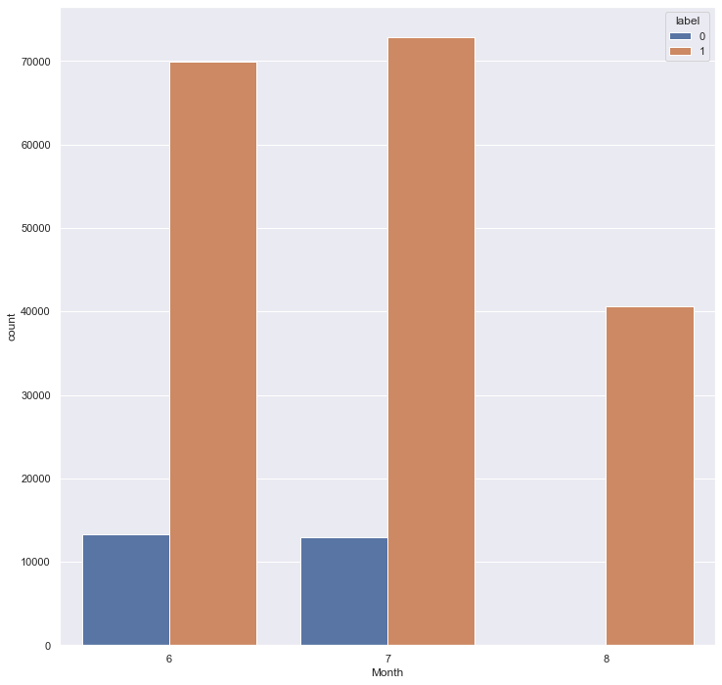
EDA (Exploratory Data Analysis)
The plot in Fig.10 is the seaborn count plot with hue as label for the Month column. We have the data for the months June, July, and August and we can conclude that the highest number of unpaid loans were in the month of June. No unpaid loans in the month of august.

Slide 17
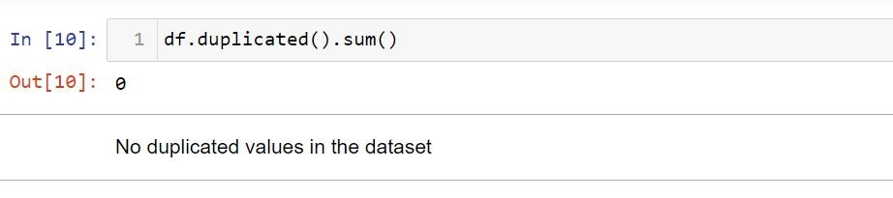
Pre-processing Pipeline
No Null values in the data set.
There were no duplicated values in the dataset.

Slide 18
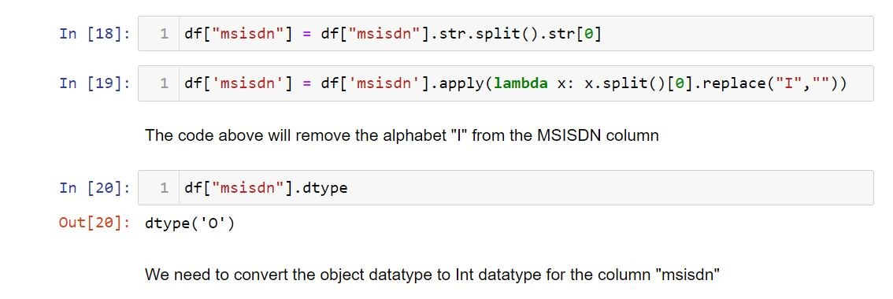
Pre-processing Pipeline
The MSISDN is Mobile Station International Subscriber Directory Number it consists of 3 sections Country code, national destination code, and subscriber number. The data type of this column must be int but due to the presence of the alphabet” I” in the mobile number it was showing object. We extracted the alphabet “I” from the column and converted the column to an Int datatype.

Slide 19
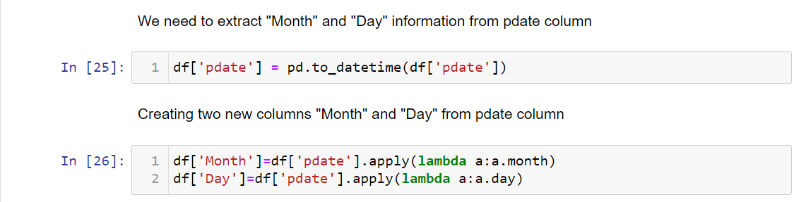
Pre-processing Pipeline
Using Pandas date time function, we extracted Month and day information from “P-date” column.

Slide 20
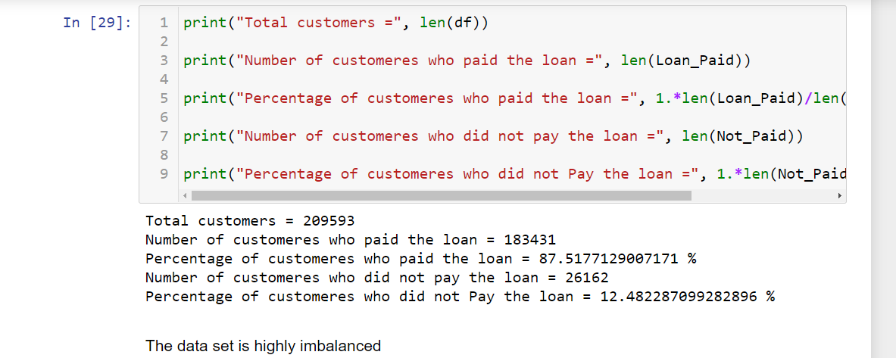
Pre-processing Pipeline
I created two new data frames “Loan_Paid” and “Not_paid” and with the help of those data frame we conclude that a total of 88% of the individuals paid the loan and 13 % were the individuals who failed to pay the loan back.

Slide 21
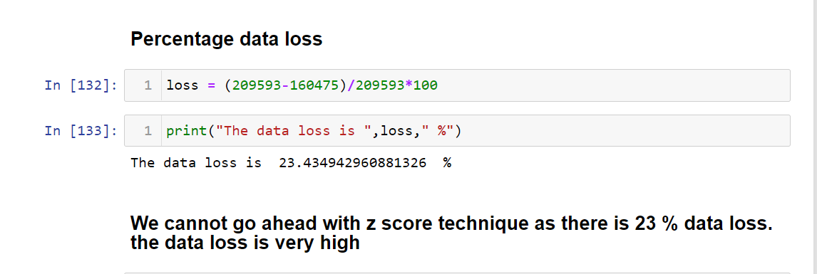
Pre-processing Pipeline
There were a lot of “Outliers” in the data set. Z score technique was used to remove the outliers but the overall data loss was more than 23% so we could not go-ahead with the Z score technique.

Slide 22
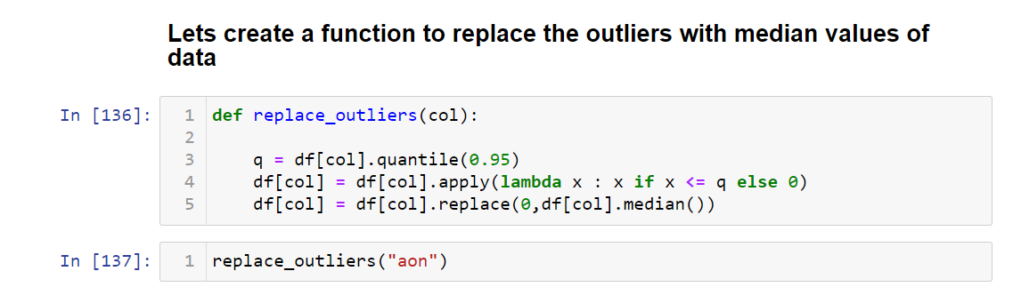
Pre-processing Pipeline
We created a function to remove and replace outliers with the median values of the data.

Slide 23
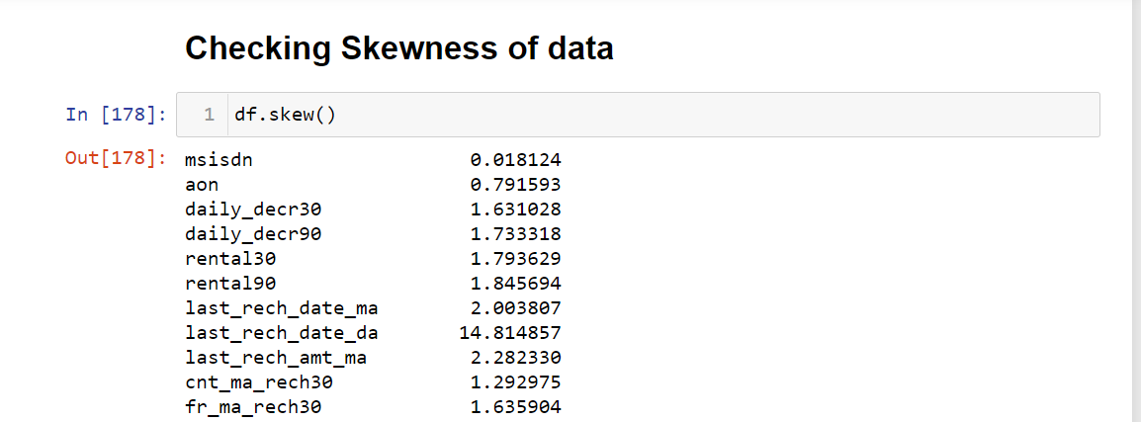
Pre-processing Pipeline
There was high Skewness in the data which was reduced with the help of log transformation and power transformation most of the skewness values were adjusted to be in the range (- 0.50, + 0.50) to achieve normal distribution.

Slide 24
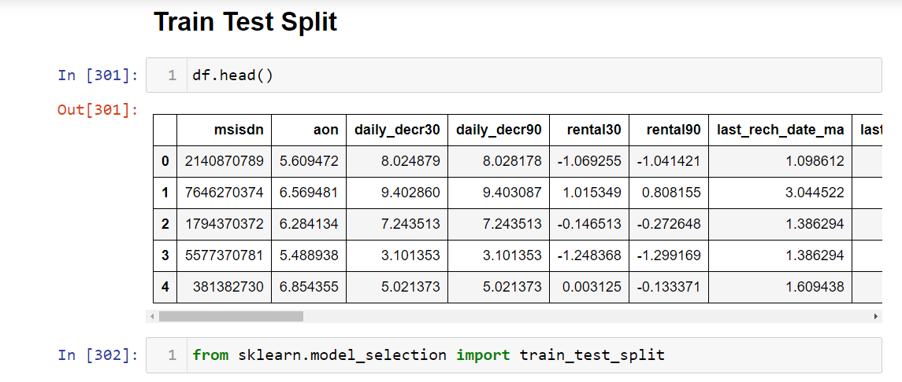
Pre-processing Pipeline
Sklearn’s Train Test split was used. And the initial random state was taken as zero.

Slide 25
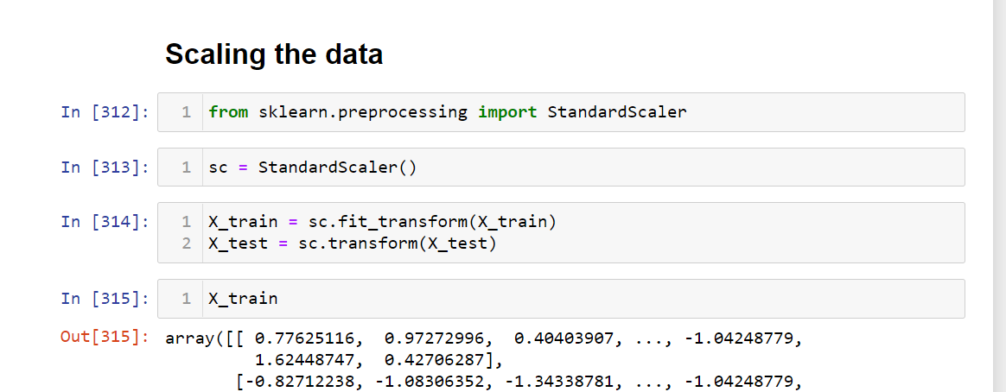
Pre-processing Pipeline
The data was Scaled using standard scalar technique from Sklearn.

Slide 26
Building Machine Learning Models
A total of 7 classification models were used in order to classify the target variable Label.
Logistic Regression.
Naive Bayes.
Random Forest Classification.
Decision Tree Classification.
ADA Boost Classifier.
K-NN Classifier.
Gradient Boosting Classifier.

Slide 27
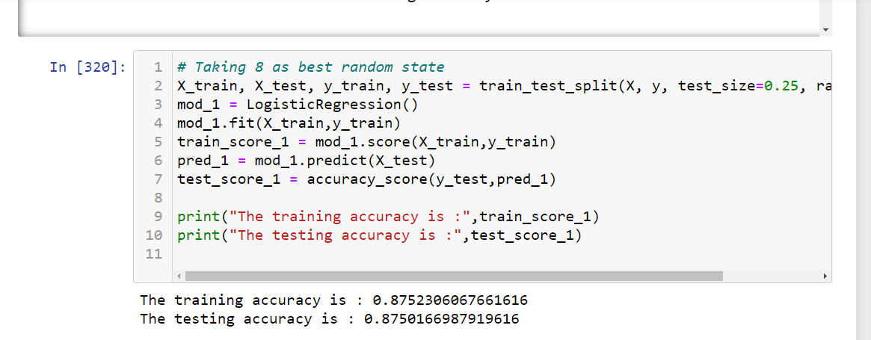
Building Machine Learning Models
Logistic Regression Results.

Slide 28
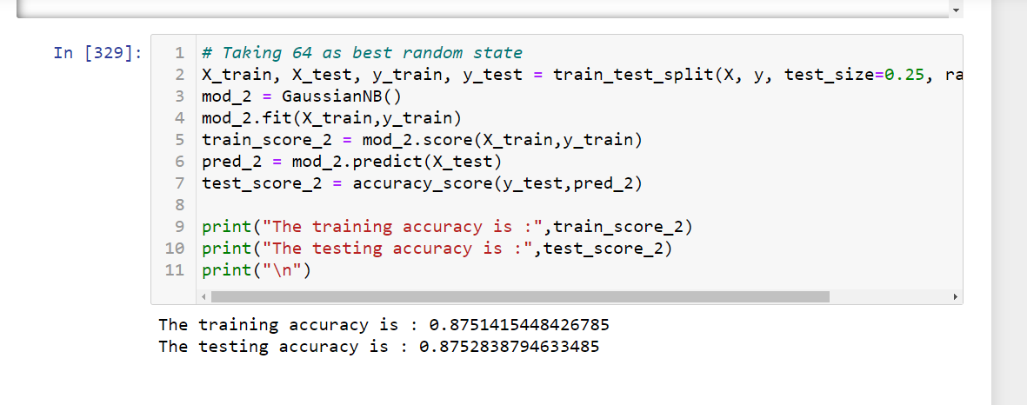
Building Machine Learning Models
Naive Bayes Results.

Slide 29
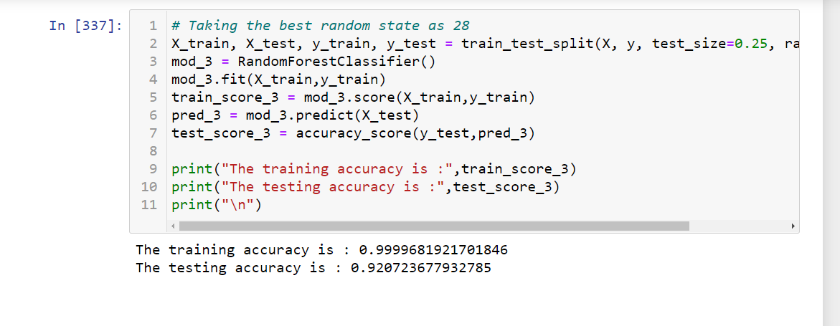
Building Machine Learning Models
Random Forest Classification Results.

Slide 30
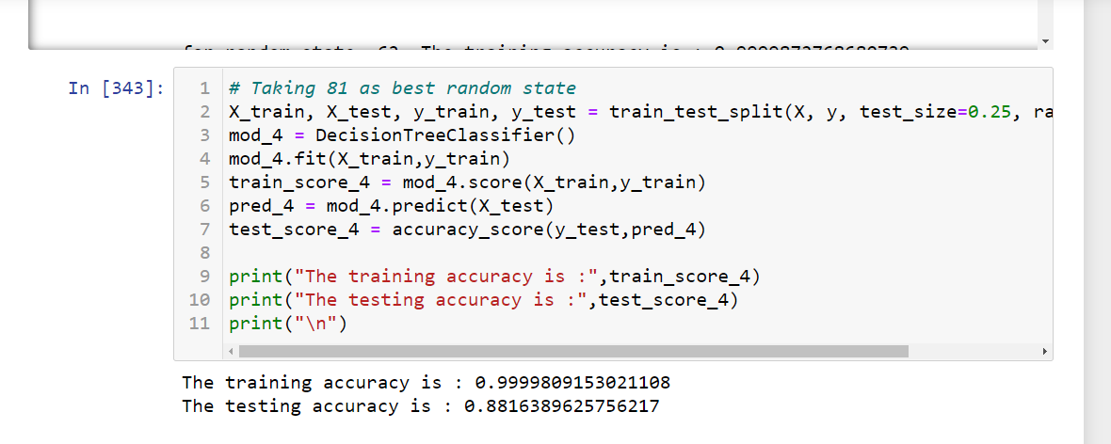
Building Machine Learning Models
Decision Tree Classification Result.

Slide 31
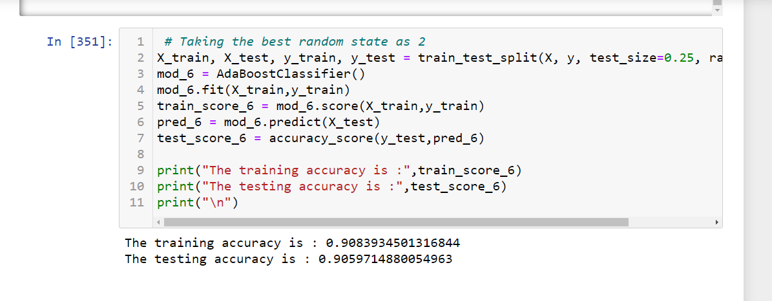
Building Machine Learning Models
ADA Boost Classifier Results.

Slide 32
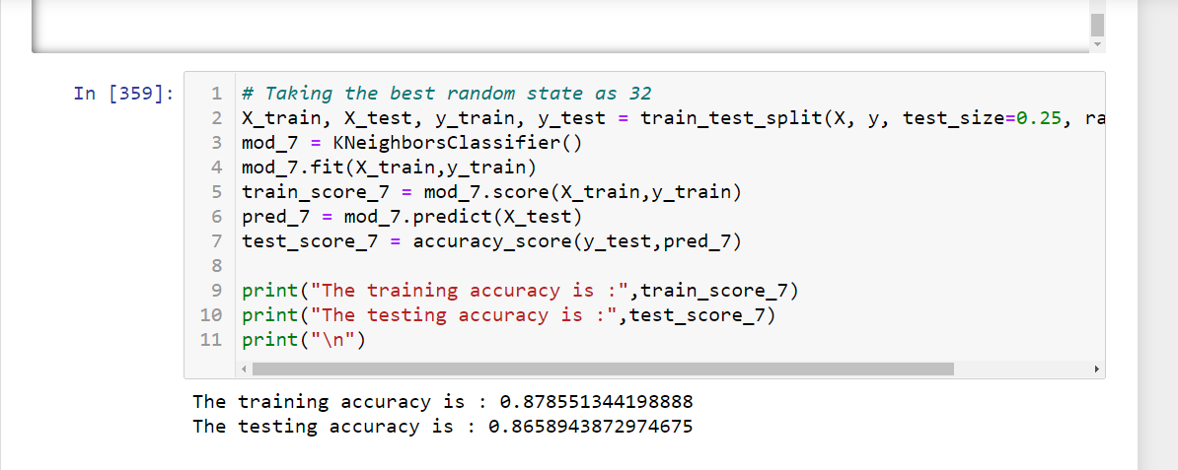
Building Machine Learning Models
K-NN Classifier Results.

Slide 33
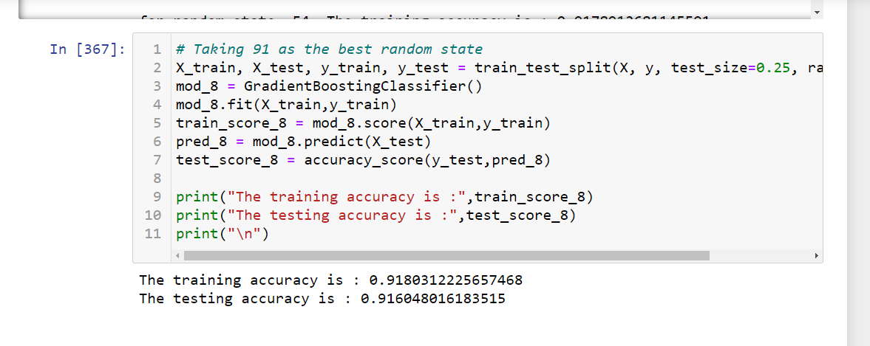
Building Machine Learning Models
Gradient Boosting Classifier Results.

Slide 34
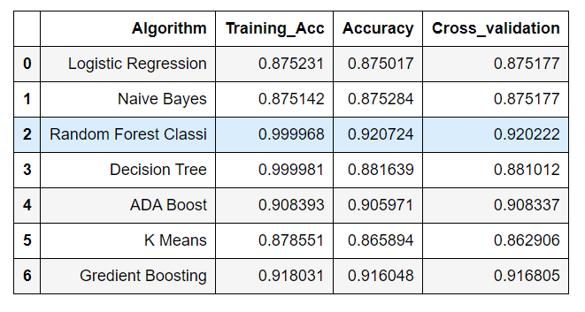
Building Machine Learning Models
Algorithm Result Table

Slide 35
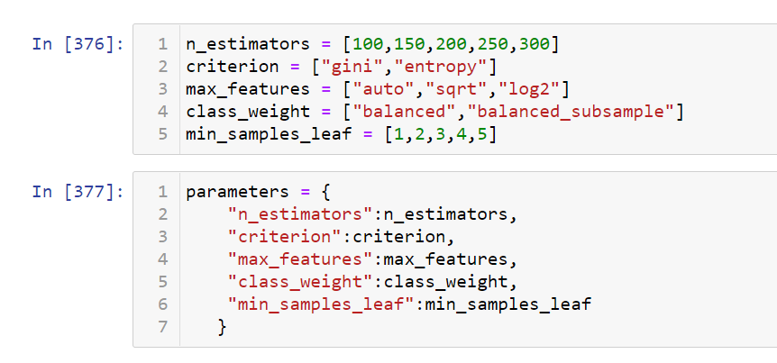
Building Machine Learning Models
Random Forest Classification (Hyper parametric tuning)

Slide 36
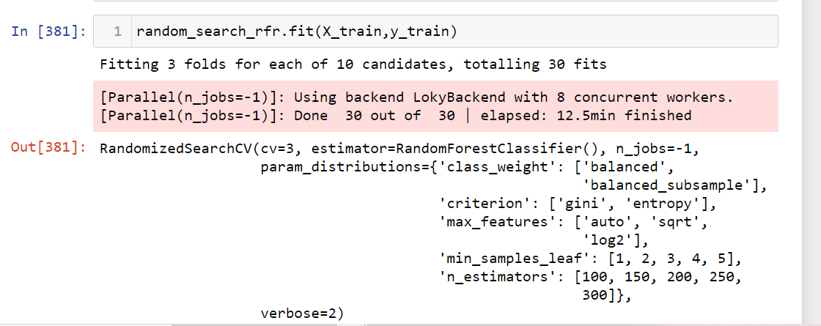
Building Machine Learning Models
Random Search CV

Slide 37
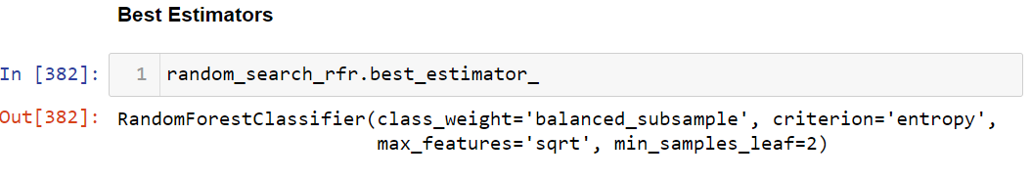
Building Machine Learning Models
Best Estimators

Slide 38
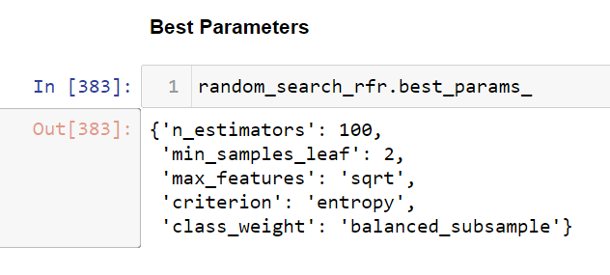
Building Machine Learning Models
Best Parameters

Slide 39
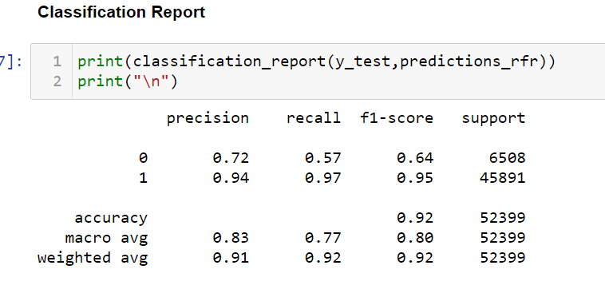
Building Machine Learning Models
Classification Report

Slide 40
Concluding Remarks
Key Findings and Conclusions of the Study
The first step I took, was to visualize the distribution of each feature and its effect on the Label (whether an Individual will repay the loan in time or not). From the analysis, I conclude that the most useful features for predictions were “Daily Decrease 30”, “Daily Decrease 90”, “Day”. The Random Forest Classifier proved to be the best model for classification based on the Cross-Validation scores. An accuracy of 0.92 % was achieved by hyperparametric tuning of the model.

Slide 41
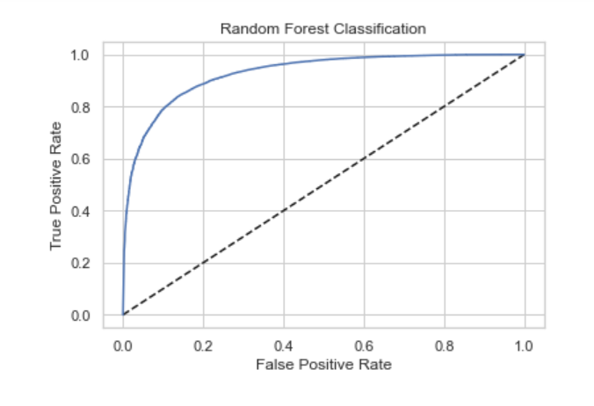
Concluding Remarks / ROC AUC Curve
The more the area under the curve the better is the model performance.

Slide 42
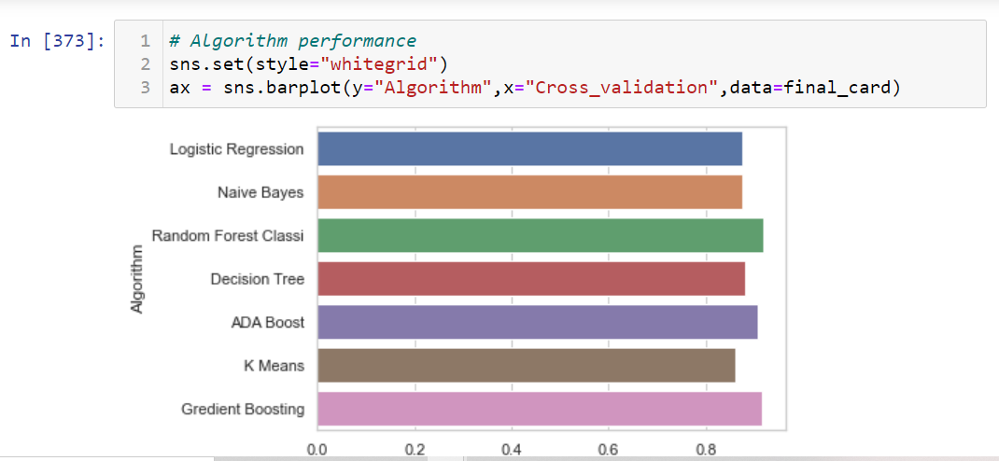
Concluding Remarks
Algorithm Performance:

Slide 43
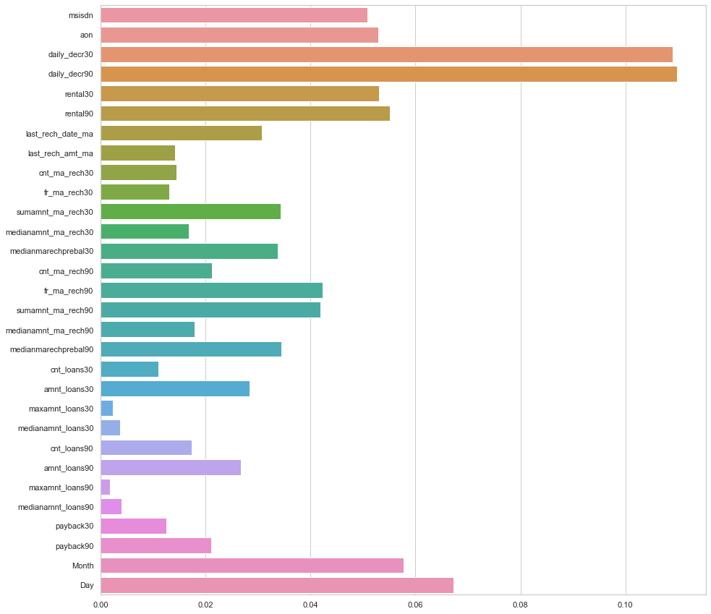
Concluding Remarks
The above plot, is a bar plot visualizing the feature importance's of all the independent variables in predicting the dependent variable Label and we can clearly conclude that the columns Daily Decrease 30, Daily Decrease 90 and Day column are turning out to be the most important features in predicting the target variable.

Slide 44
Concluding Remarks
Learning Outcomes of the Study in respect of Data Science
New Skills Acquired: Learned to perform EDA with the help of D Tale Library.
Algorithms Used: Logistic regression, Naive bayes, Random Forest classifier, Decision Tree, Ada Boost, K-NN Neighbor, Gradient boosting classifier.
Challenges Faced: The Feature Engineering and data pre-processing was quit challenging as there were a lot of non-realistic values in the dataset.

Slide 45
Concluding Remarks
Limitations of this work and Scope for Future Work
Even after getting a F1 Score for 1 to be 0.95 % the F1 score for 0 was just 64 % which can be improved. Even the Recall for 0 can be improved. But considering how unbalanced the data set was I think the results are somewhat fair. We can implement over sampling for handling imbalanced data.

